Slide 1
In Search of New Physics or
Why We Need to Talk More!
Harrison B. Prosper
Florida State University
WHEPP XIV, IIT Kanpur, India
10 December, 2015

Slide 2
Outline
  Introduction
  LHC Run I – A Random Stroll
LHC Run II – Early Results
Opportunities and Challenges
Final Remarks

Slide 3
Outline
  Introduction
  LHC Run I – A Random Stroll
LHC Run II – Early Results
Opportunities and Challenges

Slide 4
Introduction
The discovery of the Higgs boson at the LHC was a remarkable achievement.
But, equally remarkable is the astonishing reaffirmation of the predictive power of the Standard Model.
The disappointing corollary is the complete absence of compelling evidence of new physics at the LHC, so far.
Nevertheless, there is still hope that we shall not be disappointed by the end of Run II.
But, we could still be unlucky: finding no obvious resonances, but just a set of subtle spectral deviations.

Slide 5
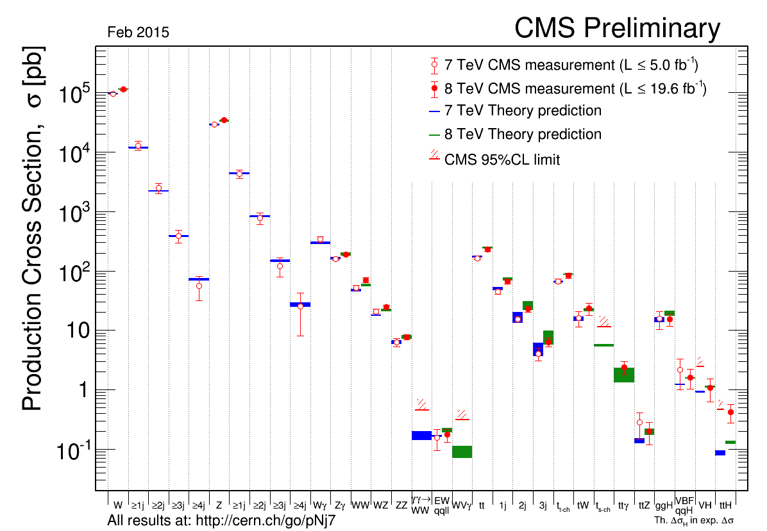

Slide 6
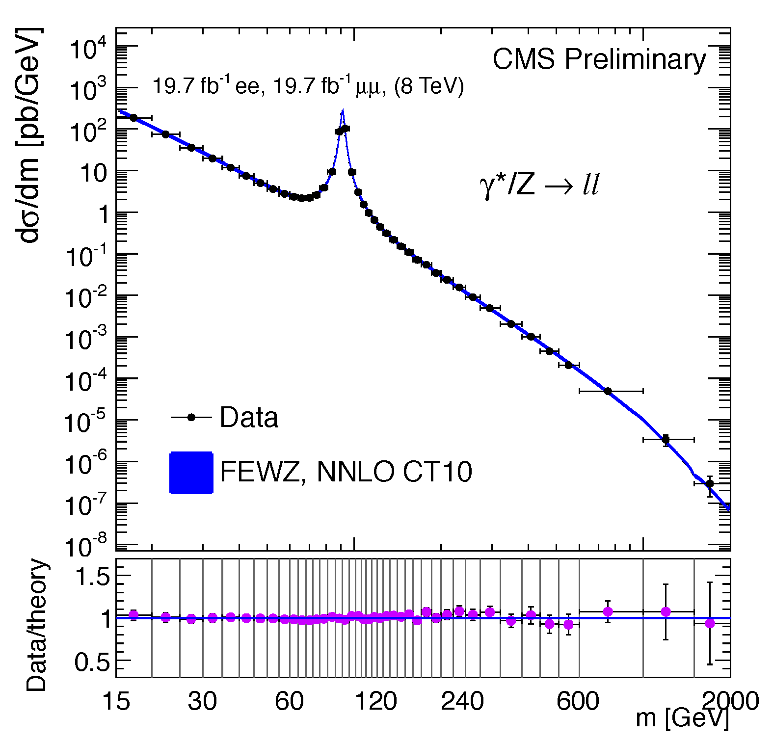
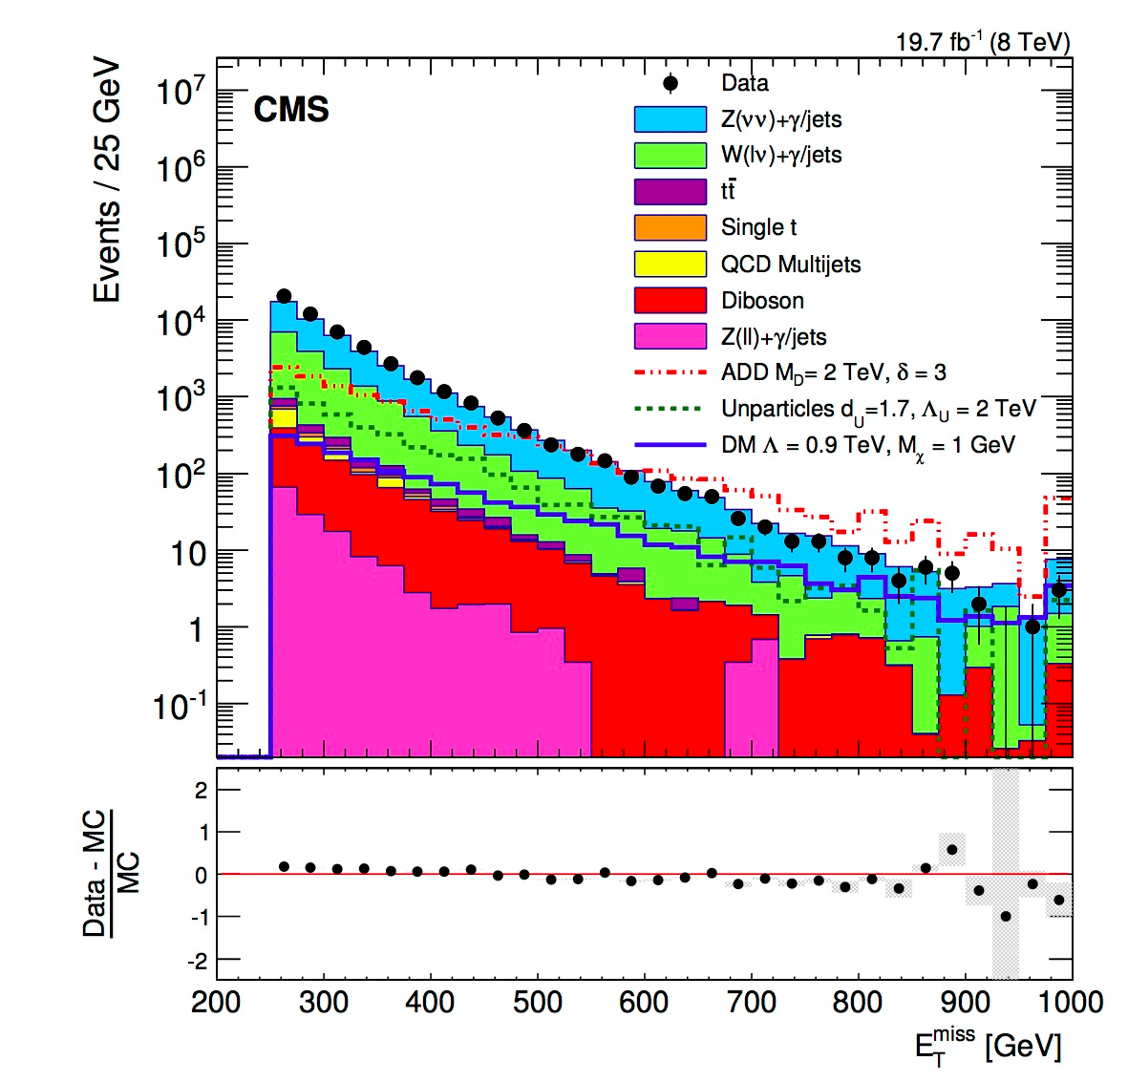

Slide 7
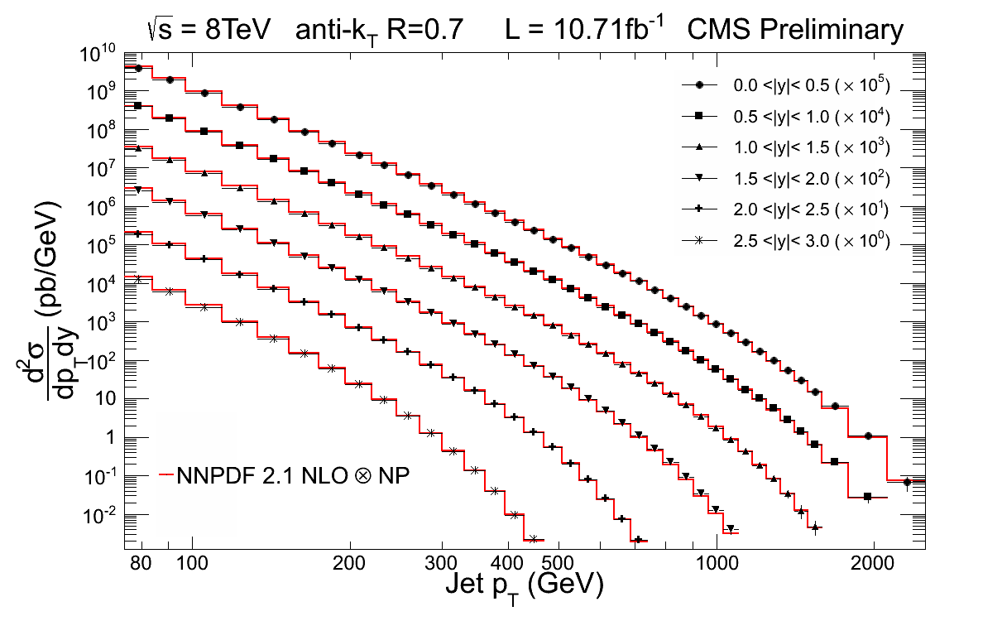
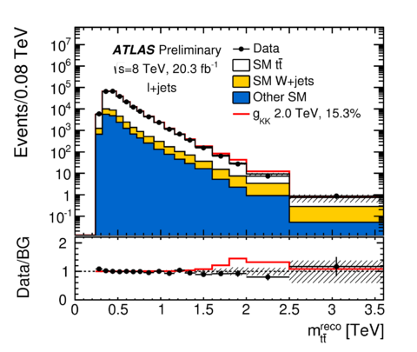

Slide 8
Introduction
Ordinarily, the remarkable level of agreement between observations and predictions should be cause for celebration.
But, that is not what we were hoping for in 2008!
Run II, however, has only just started, and hope remains a rational stance.
The fact that WHEPP is still going strong (XIV) suggests that many of you agree.

Slide 9
Outline
  Introduction
  LHC Run I – A Random Stroll
LHC Run II – Early Results
The LHC and Beyond – Opportunities and Challenges

Slide 10

LHC Run I – A Random Stroll

Slide 11
Let “N” Thousand Flowers Bloom!
Compositeness
Large extra dimensions
Heavy neutrinos
Di-boson resonances
Di-jet resonances Braneworlds
Microscopic black holes
Supersymmetry Leptoquarks
Walking, crawling, semi-comatose Technicolor
Strings Excited fermions

Slide 12
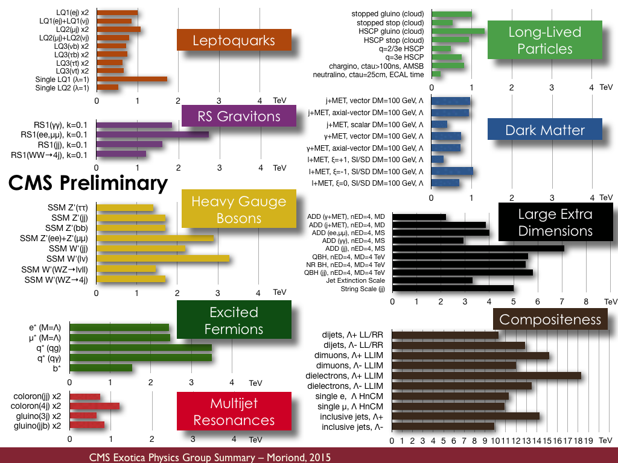
Let A Thousand Flowers Bloom!

Slide 13
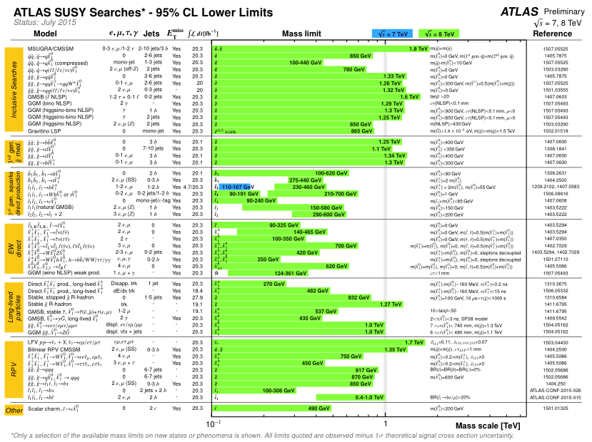
Desperately Seeking SUSY!

Slide 14
Searching for Resonances
Resonances, such as
excited quarks
W and Z primes
Randall-Sundrum gravitons
Axigluons,
to name but a few, are a generic prediction of many models of beyond the SM physics.
A systematic search for resonances should be a priority.

Slide 15
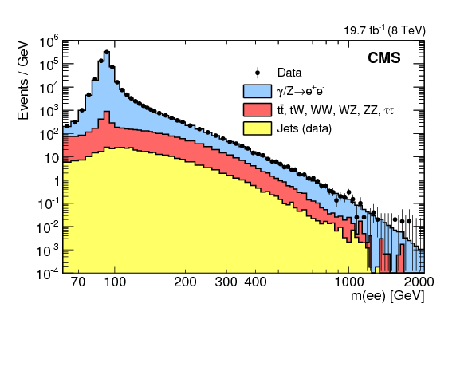
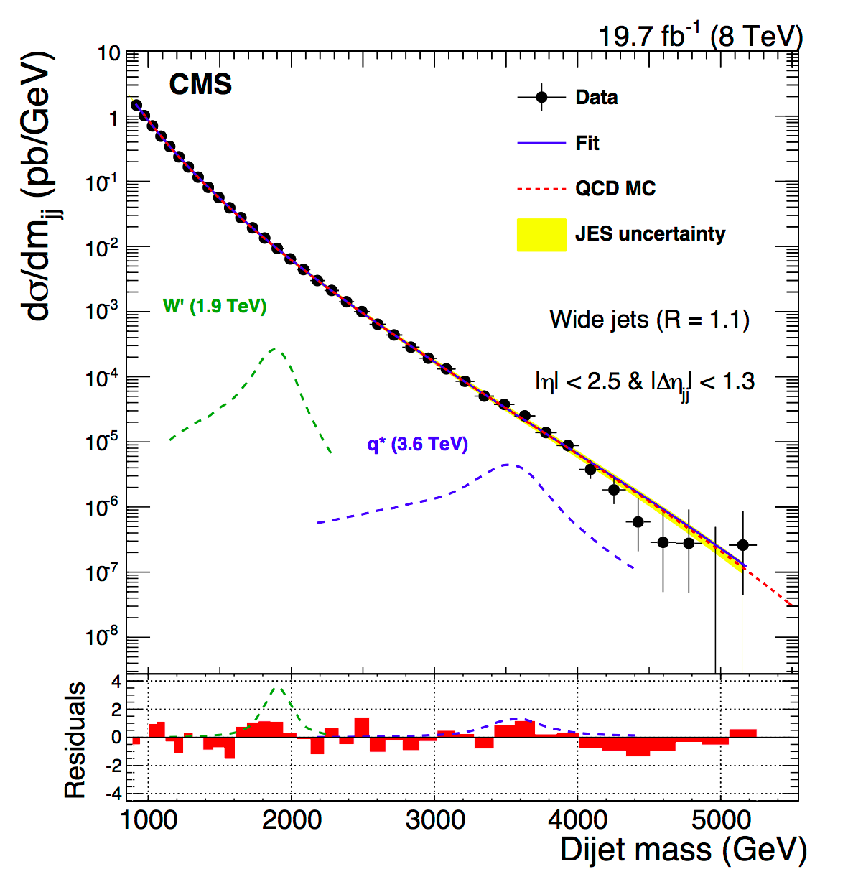
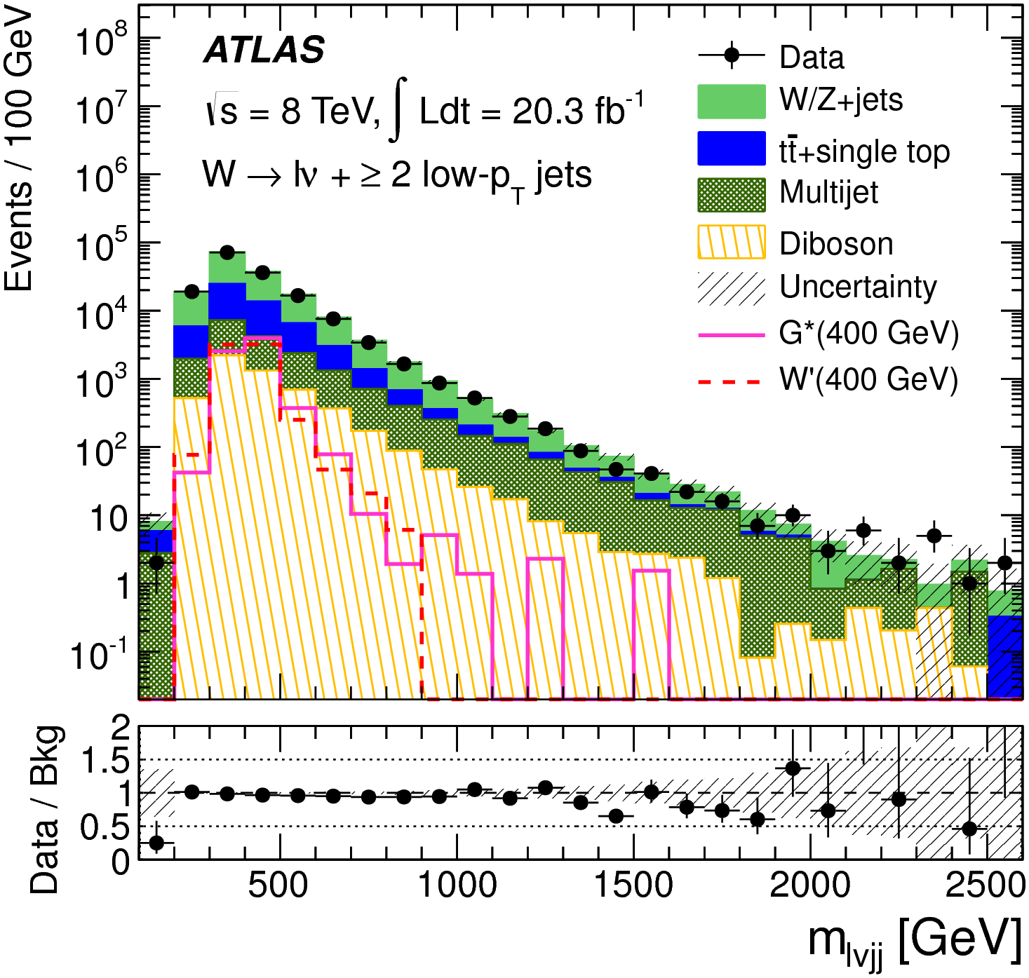
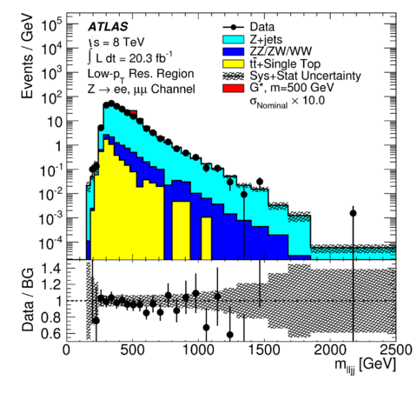
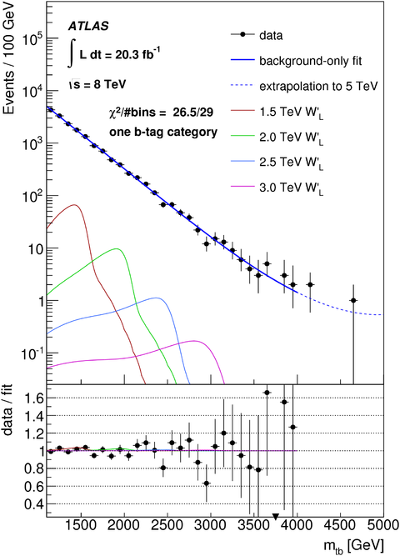
Searching for Resonances
dijets
dibosons
dileptons
W’
dibosons
W’

Slide 16
A (Cautionary) Tale of Resonances
Today, no discovery in our field is more convincing than observing a peak, especially if narrow, on top of a smooth monotonic background.
But, we should tread carefully…

Slide 17
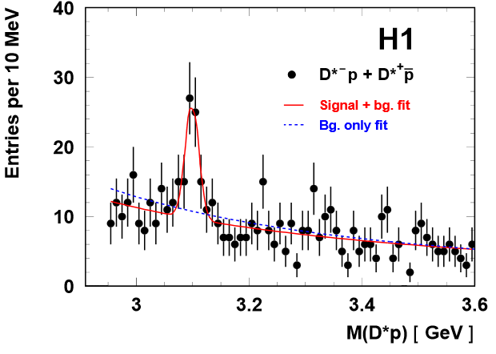
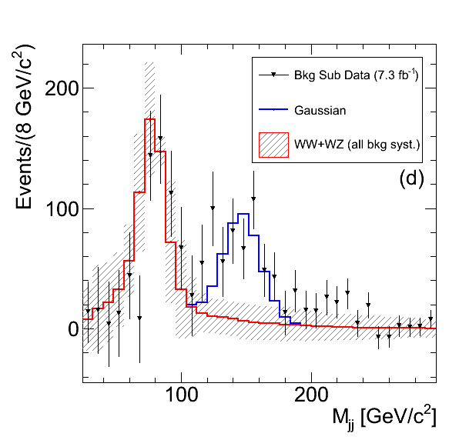
Resonances That Aren’t!
H1 6σ pentaquarks
hep-ex/0403017
CDF 4σ dijet bump
http://arxiv.org/abs/1104.0699

Slide 18
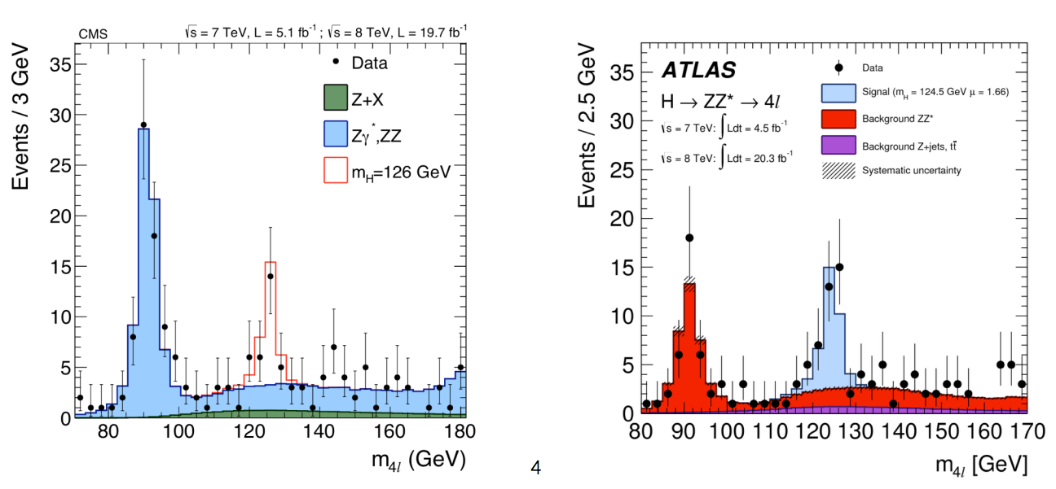
And Resonances That Are!
CMS, ATLAS, Higgs boson, > 5σ

Slide 19
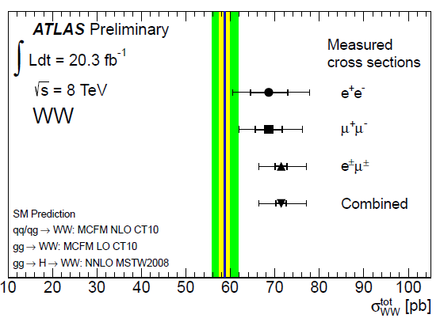
A (Cautionary) Tale of an Excess
CMS and ATLAS measured a cross section ~20%
higher than the NLO SM prediction.
This exciting result triggered a frenzy of speculation:
arXiv:1406.0848
arXiv:1406.0858
arXiv:1407.4912, etc.

Slide 20
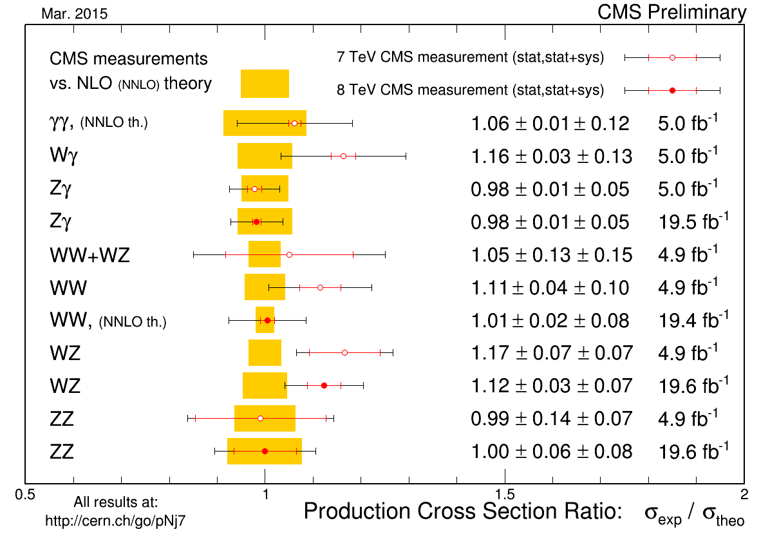
A (Cautionary) Tale of an Excess
My colleagues Jaiswal and Okui (arXiv:1407.4537), and Meade, Ramani, and Zeng (arXiv:1407.4537) noted that the jet veto cut p_{T} > p_{T,veto}, used by ATLAS and CMS to reduce background from top quark production, renders the NLO calculation inaccurate because terms like log^{n}(M/p_{T,veto}) now need to be included. Improved calculations brought better agreement.
  Finally, a NNLO calculation of
  the WW cross section
  (Phys. Rev. Lett. 113, 212001
  (2014)) is found to agree with
  the measurements:

Slide 21
So How Sure is Sure Enough?
  Our field uses a rigid 5σrule to claim a discovery. But, is this sensible?
  Louis Lyons argues perhaps not: http://arxiv.org/pdf/1310.1284v1.pdf.
  The point is whether you accept a statistically significant hypothesis H₁ depends on your prior opinion (π) about that hypothesis:

Slide 22
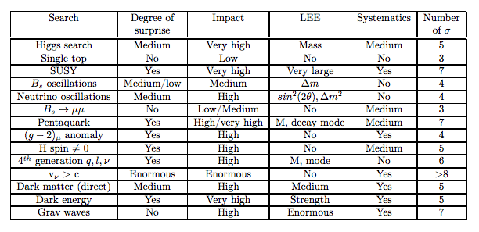
So How Sure is Sure Enough?
  http://arxiv.org/pdf/1310.1284v1.pdf

Slide 23
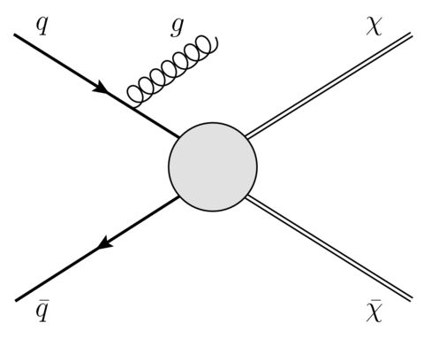
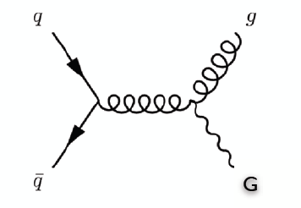
The Mono X Program
or Clapping With One Hand!
Looking for “nothing”
recoiling against
something (X = e.g., a jet).

Slide 24
The Mono X Program
Example: 8 TeV ATLAS mono-jet search (1502.01518, 15 Sep 2015) imposed the requirements
to select mono-jet like events.
All backgrounds (single-boson, di-boson, top quark) are simulated, except for multi-jets and non-collision events, which are estimated using data-driven methods.

Slide 25
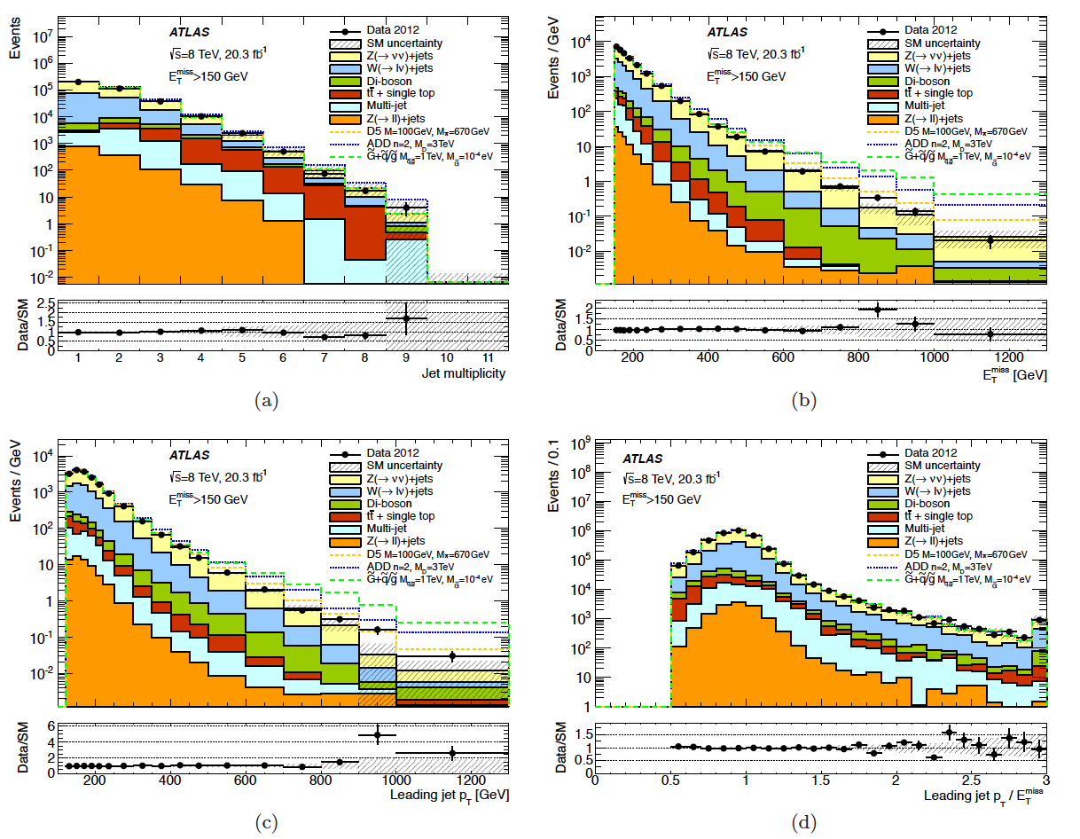
ATLAS 1502.01518, 15 Sep 2015

Slide 26
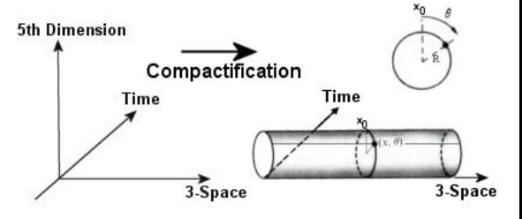
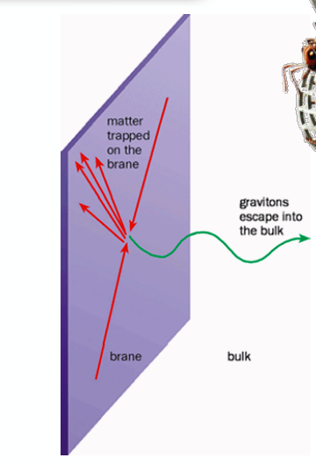
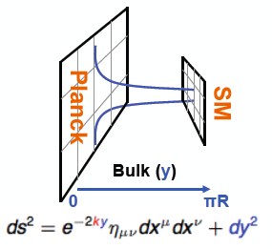
The Mono X Program
Arkani-Hamed
Dimopoulos
Dvali
Randall
Sundrum

Slide 27
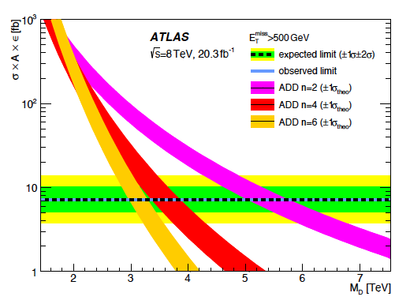
The Mono X Program

Slide 28
Outline
  Introduction
  LHC Run I – A Random Stroll
LHC Run II – Early Results
Opportunities and Challenges

Slide 29
Early Commissioning Results

Slide 30
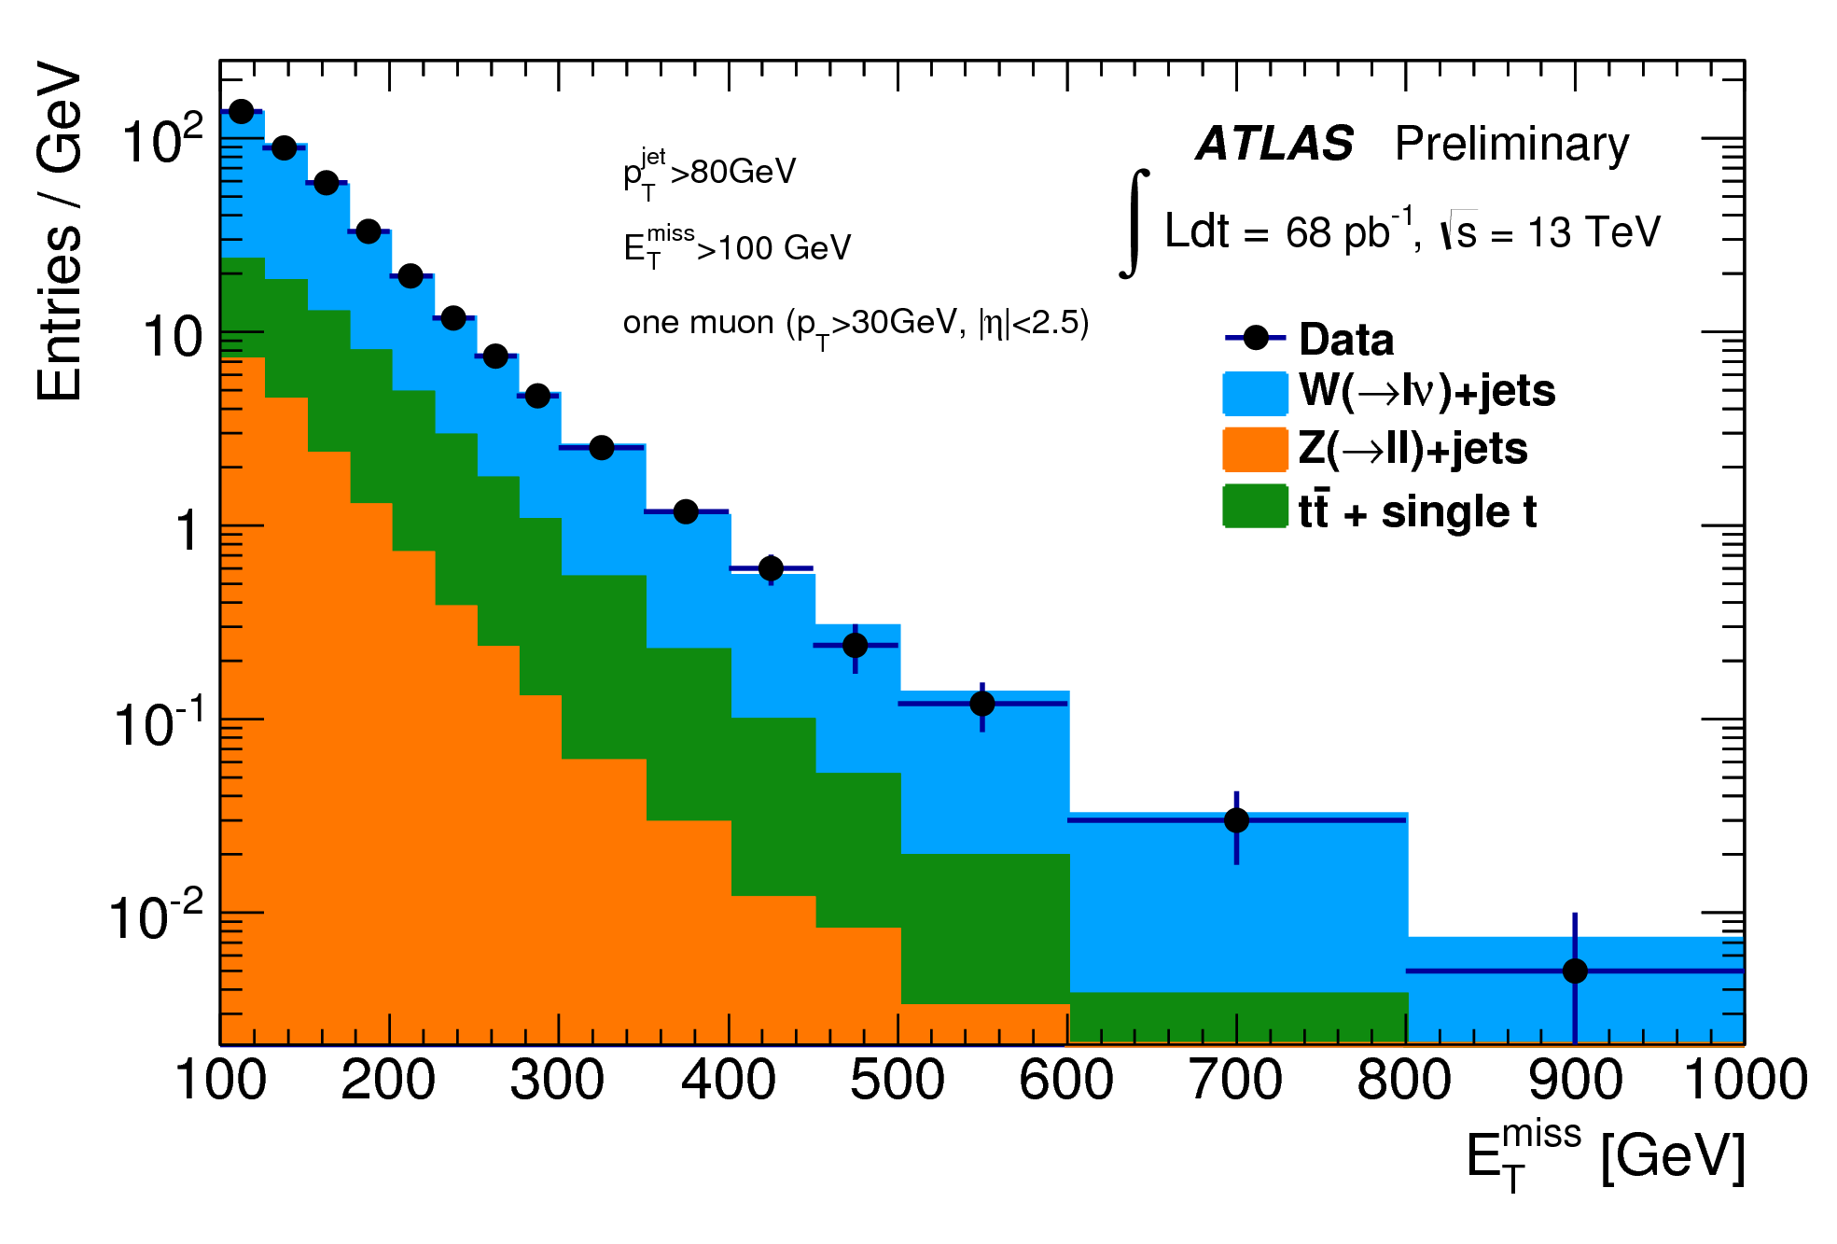
ATLAS@13 TeV: Breathtaking!

Slide 31
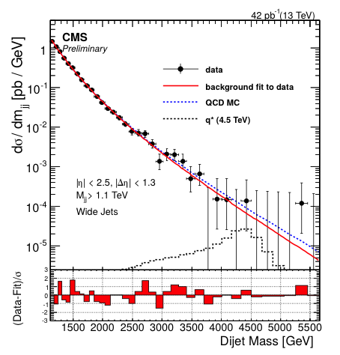
Resonance Searches – Round 2
CMS search for a narrow
resonance in dijet
mass spectrum
Background modeled with

Slide 32
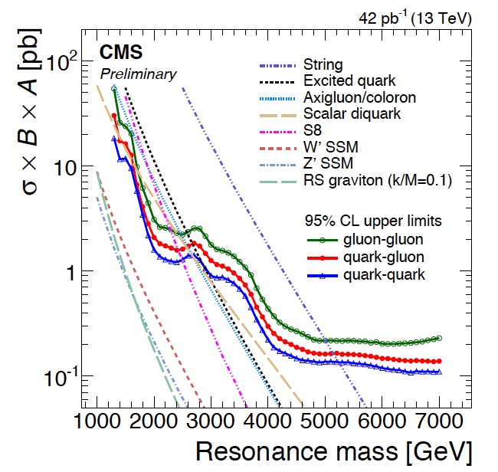
Resonance Searches – Round 2
As expected, this
search can be
used to set limits
on many models:
But, yet again, the
Standard Model
reigns supreme!

Slide 33
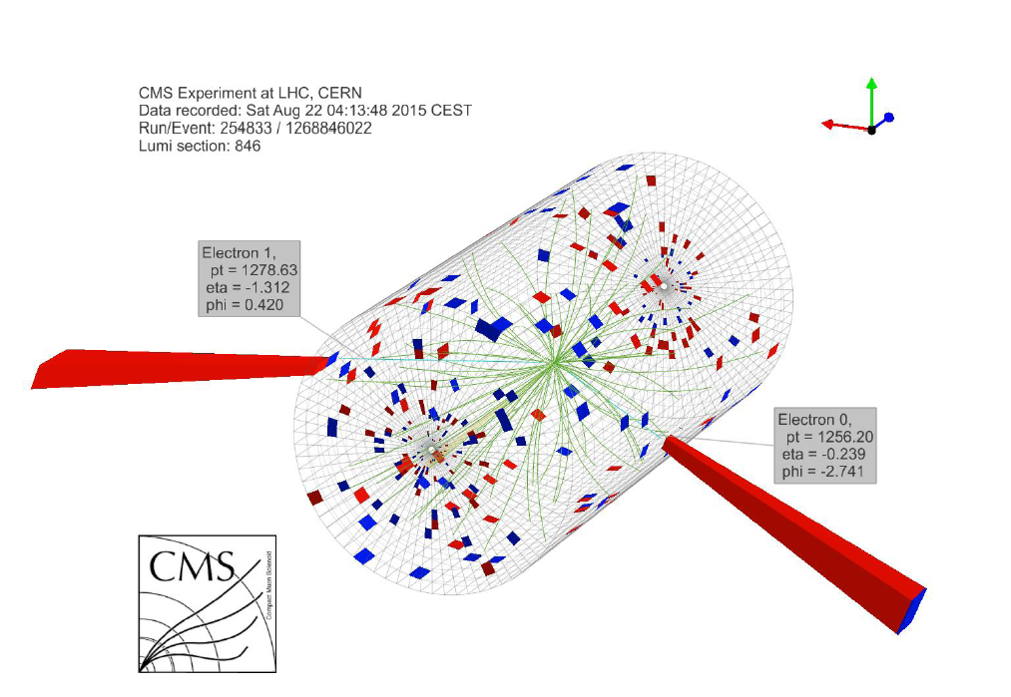
A 2.9 TeV Di-Electron Event
p_{T1} = 1.28 TeV, η₁= –1.31, ϕ₁ = 0.42
p_{T2} = 1.26 TeV
η₂ = –1.24,
ϕ₂ = –2.74
Expected
background
above 2 TeV
0.007 events

Slide 34
Outline
  Introduction
  LHC Run I – A Random Stroll
LHC Run II – Early Results
Opportunities and Challenges

Slide 35
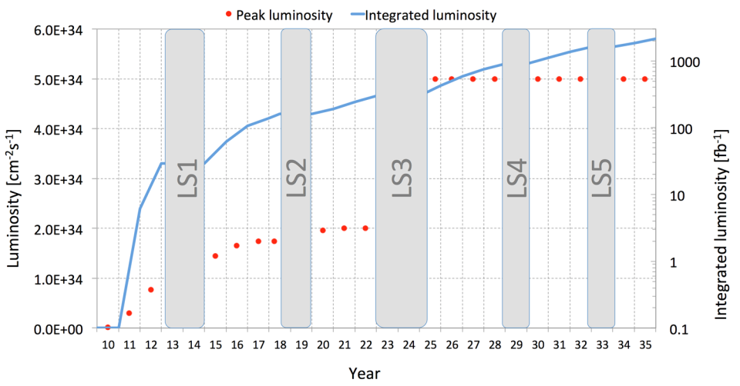


Opportunities & Challenges
Run 1
Run 2
Run 3
Run 4
7-8 TeV
13-14 TeV
<PU>≅ 140
<PU>≅ 60
<PU>≅ 40
<PU>≅ 21
25ns
bunch spacing
HL-LHC

Slide 36
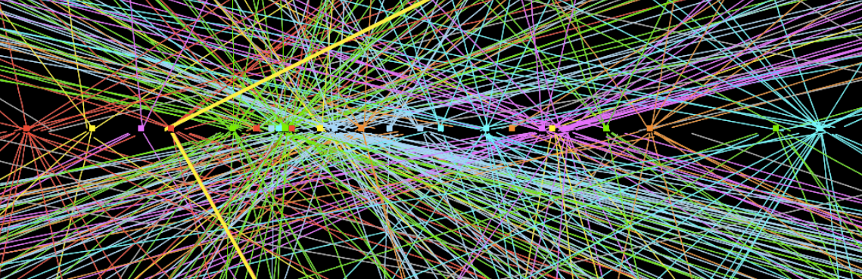
Opportunities & Challenges
The upgraded LHC and its amazing detectors provide the best chance we have to move the field significantly forward.
The opportunities for young physicists to make lasting contributions are enormous. They are so precisely because of the many challenges we must face!
Take, for example, pileup:

Slide 37
Opportunities & Challenges
At L ~ 1.3 x10³⁴ cm⁻² s⁻¹, find ~140 vertices spread over 5 cm!

Slide 38
Opportunities & Challenges
A Few Experimental Challenges
  Handle data storage at the rate of 6 gigabytes/second
  Trigger efficiently, even at low thresholds
  Mitigate the effects of pileup
  Efficient identification of boosted W, Z, Higgs, top
  Efficient identification of b jets and taus
  High fidelity, yet fast, detector simulation
  Automatic search for deviations from SM
A Couple of Theoretical Physics Challenges (my wish list!)
  Fully automatic high precision predictions for hundreds of SM exclusive final states.
  Precise calculation of multijet cross sections, finally!

Slide 39
Opportunities & Challenges
Where does our field want to be in 2050?
We want to be in possession of the New Standard Model.
However, for that to happen, two things are necessary:
  We must discover new physics, and
  we must significantly narrow the divide between theorists and experimentalists: We Need To Talk More.
But, for the latter to happen, a major cultural shift will be necessary.

Slide 40
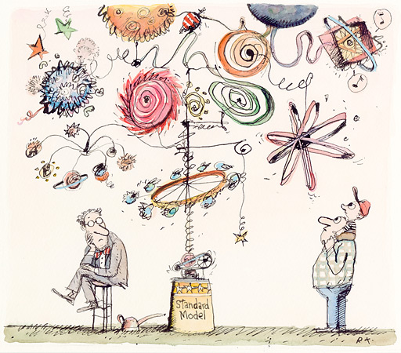
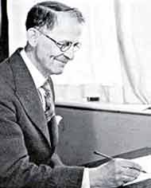
Final Remarks
The Standard Model – a complicated Heath Robinson edifice ingeniously put together by brilliant architects and builders – is to be celebrated as a truly magnificent achievement.
But the NSM will be even more
extraordinary.
William Heath
Robinson
1872 – 1944

